Slide 1
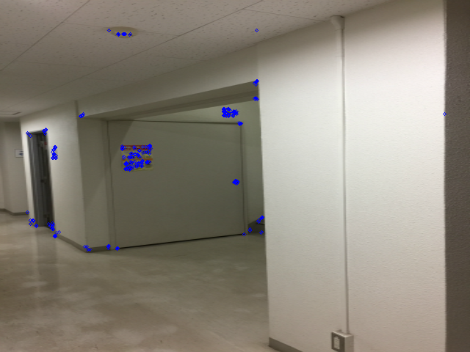
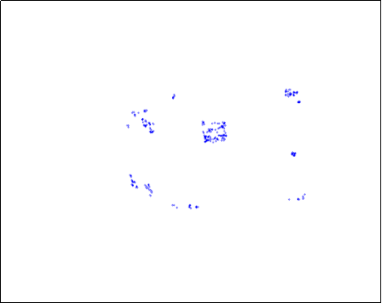
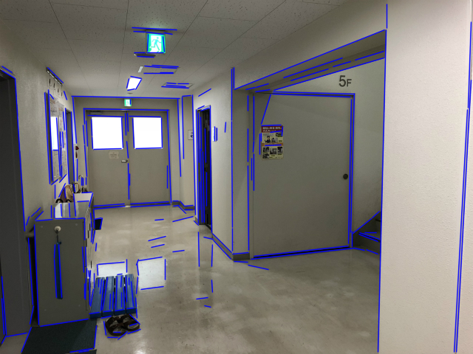
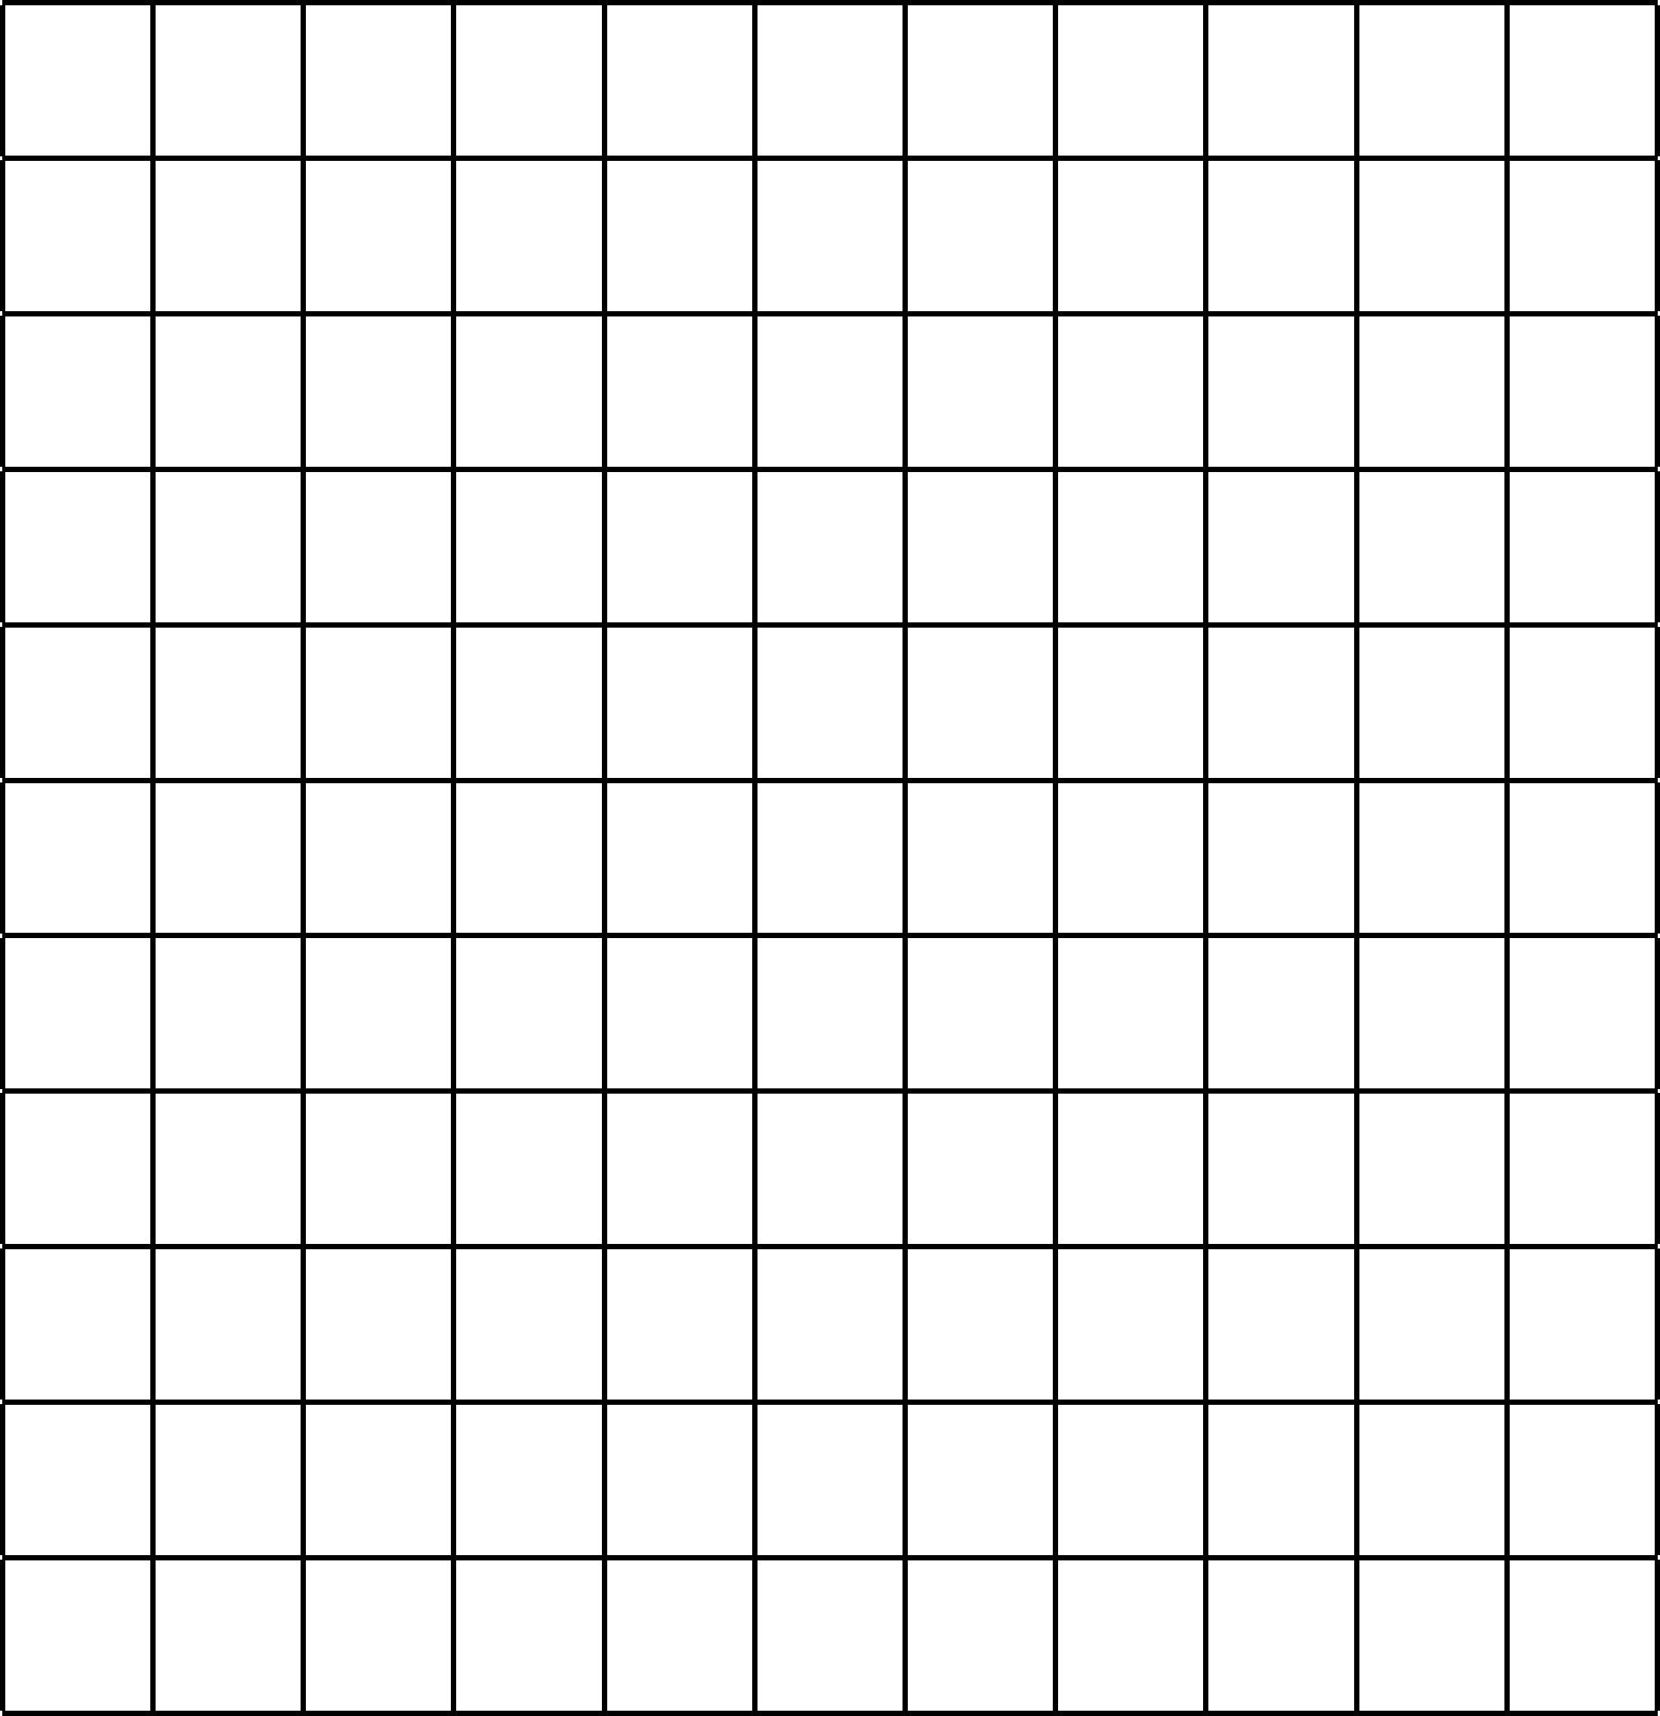
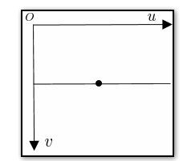
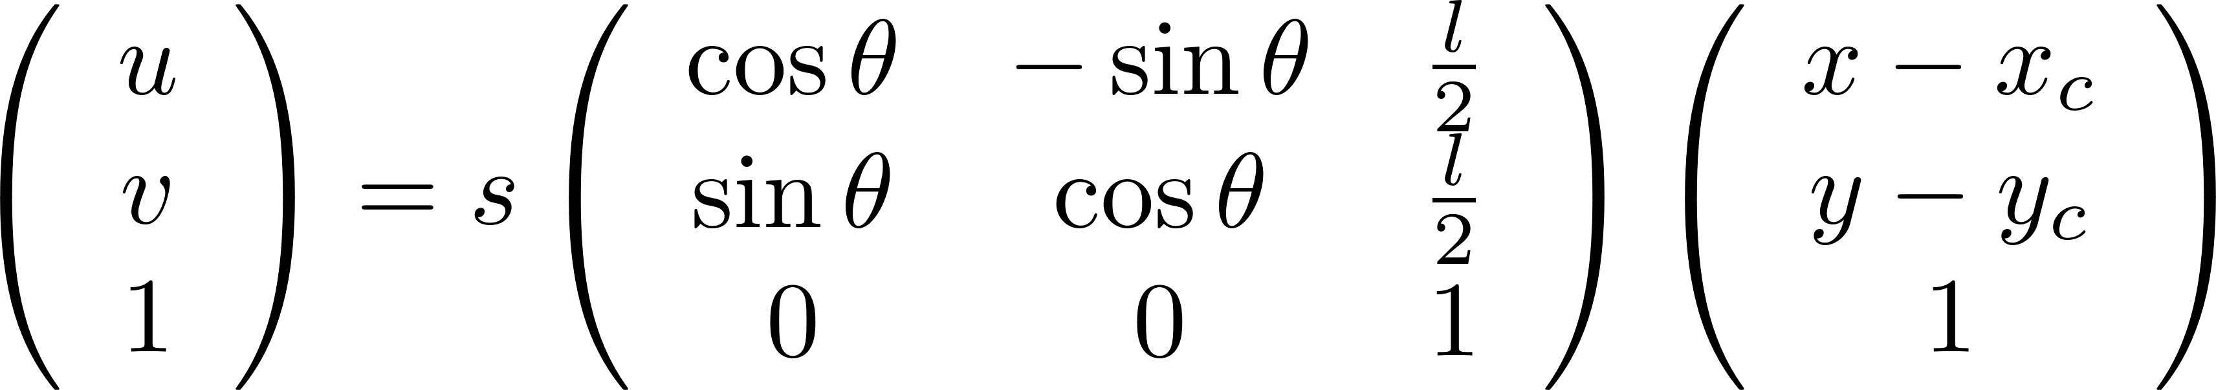
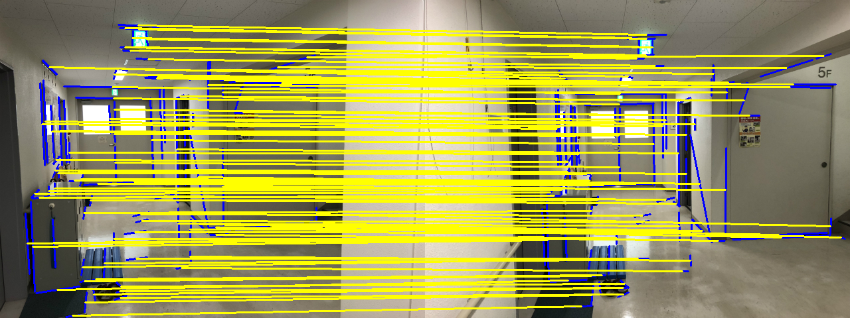
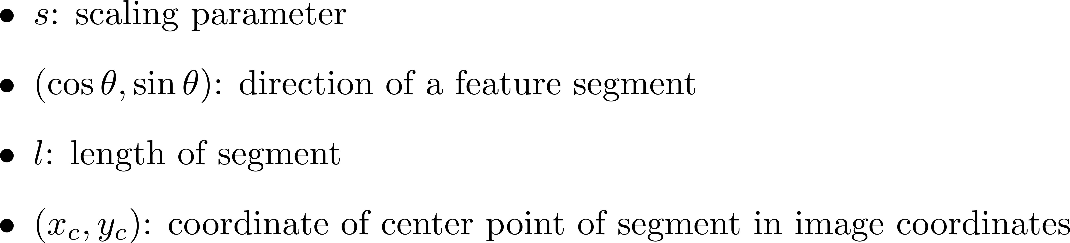
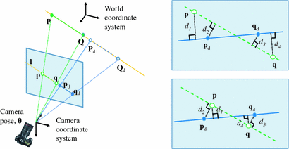
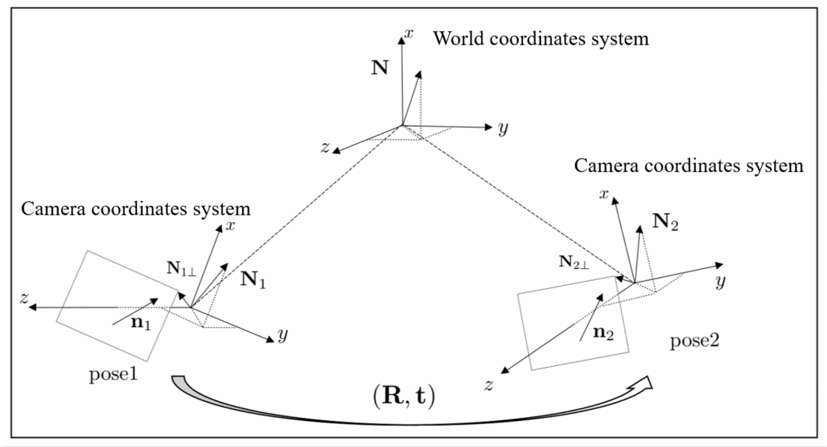
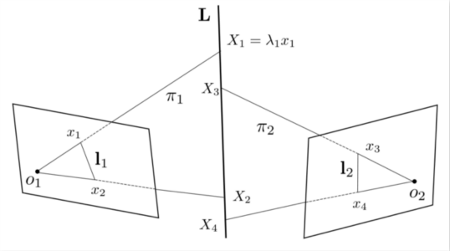
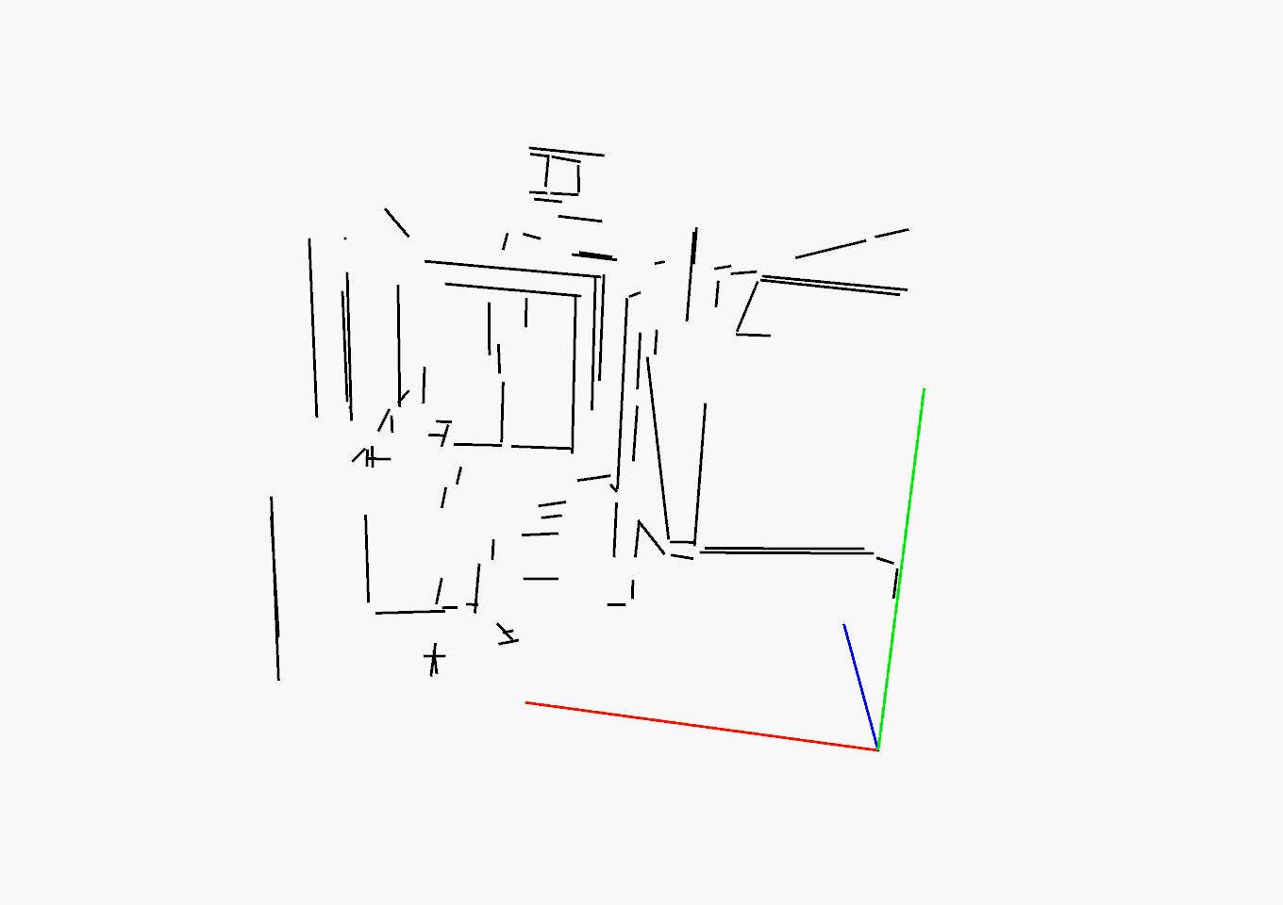
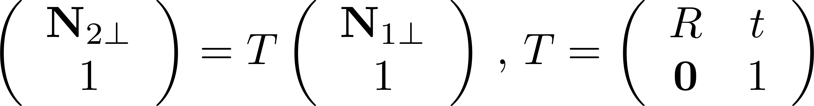
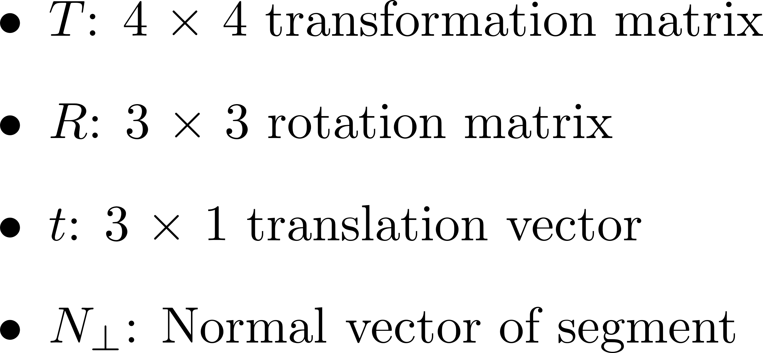

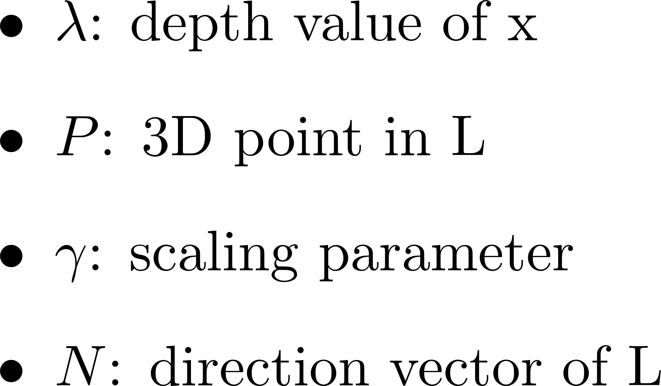
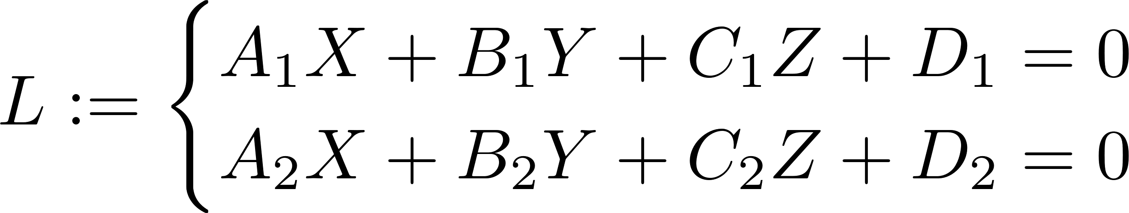
Line-SLAM: Line-based Feature Matching in Textureless Environment for 3D Reconstruction
YU Zhengnan, TAKAHASHI Hiroki
Background
SLAM: The core of autonomous driving and robotic movement
Inapplicability of Key-point based in the textureless environment
(a)
(b)
Fig1. An example of ORB[rublee’11] feature matching
Process Overview
Feature Matching
Line-SLAM
Localization
Mapping
Feature Matching
Depth Calculation
Fig2. Segments detection by LSD[von’12]
Fig3. Local region normalization for
BRIEF[calonder’10] descriptor computing
Pose Estimation
3D Reconstruction
Global Optimization
Fig4. Matching result
Camera Pose Estimation
3D Reconstruction
Fig5. Camera Projection Model
Fig6. Geometry correspondence
Fig7. 3D Line reconstruction
Fig8. Recovered 3D lines
Future Works
Detect the obstacles by images processing
Robust to dynamic objects
Fast relocalisation

